Slide 1
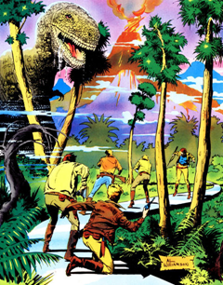
Ray Bradbury: A Sound of Thunder

Slide 4
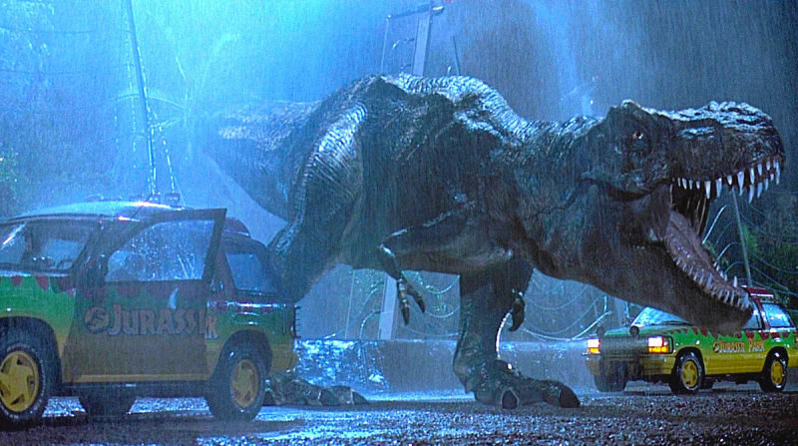

Slide 5
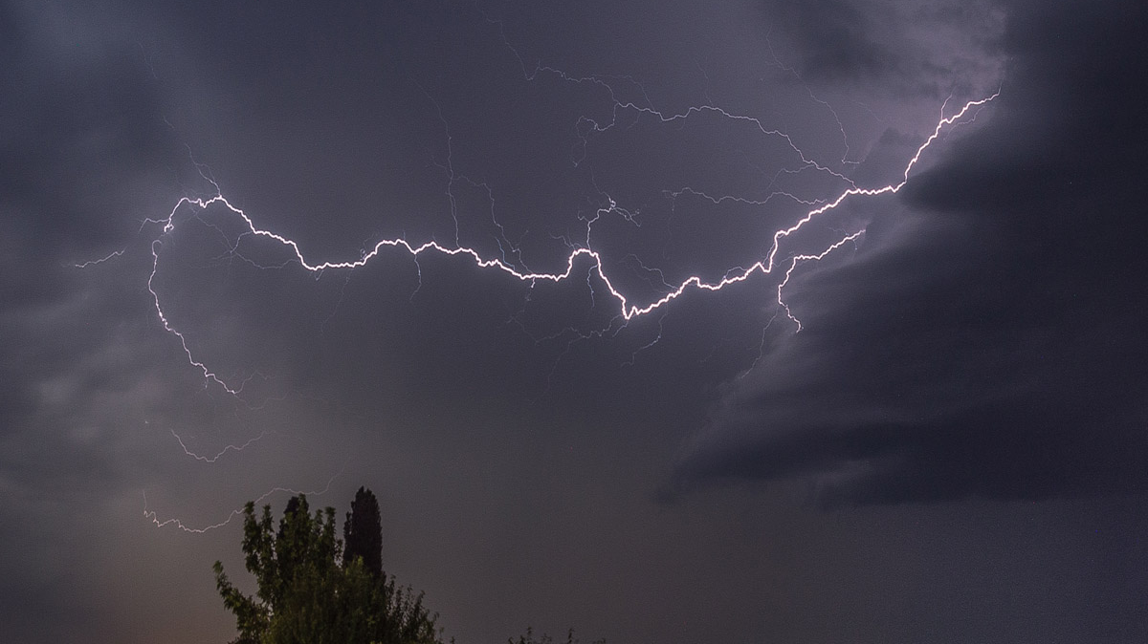

Slide 6
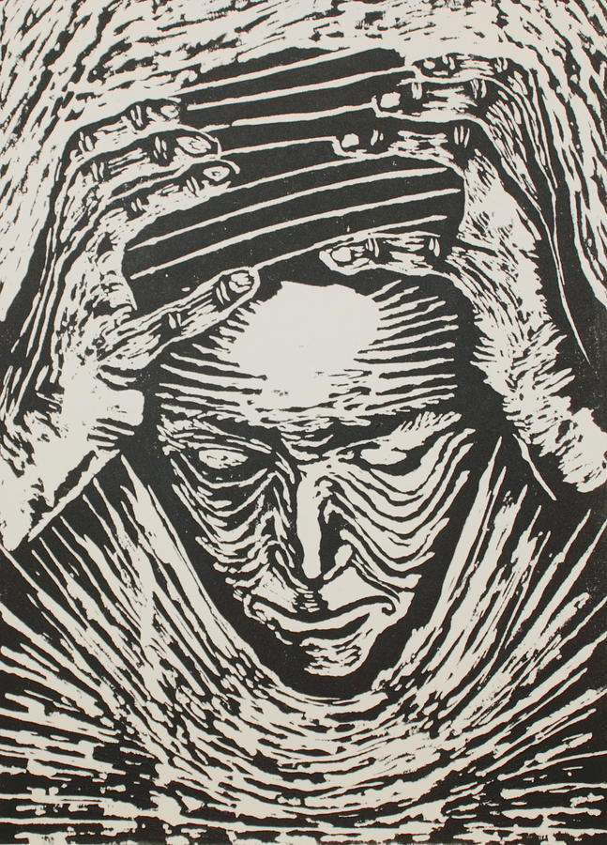

Slide 9
Sources
https://media.npr.org/assets/img/2014/06/12/istock_000021413472medium_wide-88fde59b7b495957baff87acabdcc54d7cb3b852.jpg?s=1400
http://daily-sun.com/post/223453/Met-office-predicts-rain-or-thundershowers
https://wallup.net/landscape-trees-path-rain-clouds-field-dirt-road/
https://gizmodo.com/how-much-force-could-a-t-rex-bite-deliver-1795220916
https://fineartamerica.com/featured/total-confusion-tamra-davisson.html
http://jonathanbecher.com/2017/08/27/a-sound-of-thunder-and-the-butterfly-effect/#lightbox/0/
http://www.scaryforkids.com/a-sound-of-thunder/

